Slide 1
“I WISH I HAD DONE MORE!”*
Diversity and Inclusion in the Workplace
* Executive and MHTA ACE Program Speaker
MHTA Small Group Project
11th October 2019

Slide 2
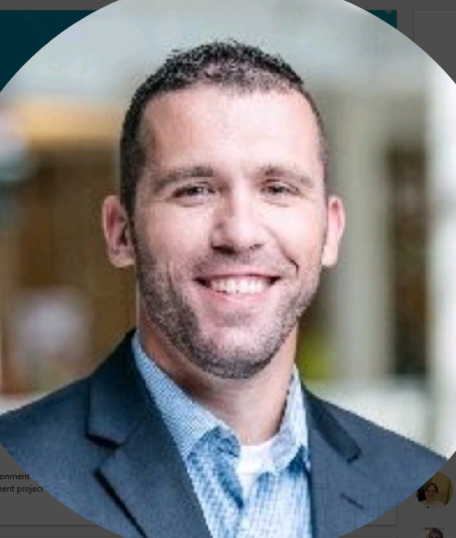
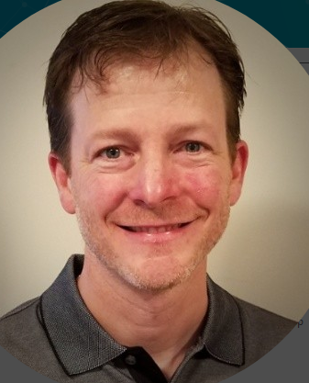
Meet The Diversity and Inclusion Team
Need John’s image
Patrick Wand
Sr IT Project Manager
Mall of America
Kevin Flanders
Sr Engineering Manager
Unisys
John Duda
Managing Principal Engineer
Seagate
“In the US there are more people by the name of John leading major companies than there are women leading major companies” (source NY Times Analysis, 2018)
Notes:
This is despite the fact that women make up 50.8 percent of the U.S. population and 57 percent of college graduates, while Johns make up only 3.3 percent of those groups.

Slide 3
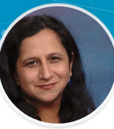
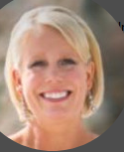
Also Introducing…...
Pooja Arora
Director - PMO
PTC
Nikki Shaffer
Sr IT Manager
Seagate
We have hit our diversity goal!!

Slide 4
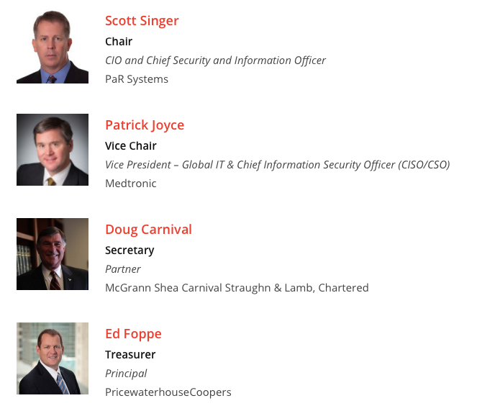
Out of curiosity, let’s take a look at the MHTA board…..
“Are we putting our money where our mouth is?”

Slide 5
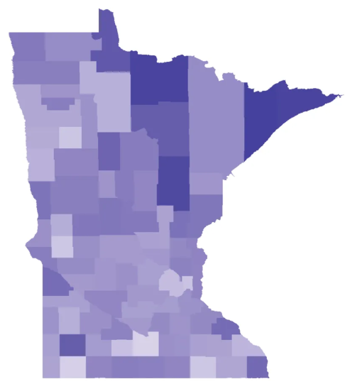
Corporate Diversity Programs In Play
All corporations have high profile programs to show their commitment and intent to D&I in the workplace
About 8 billion dollars spent nationwide!

Slide 6
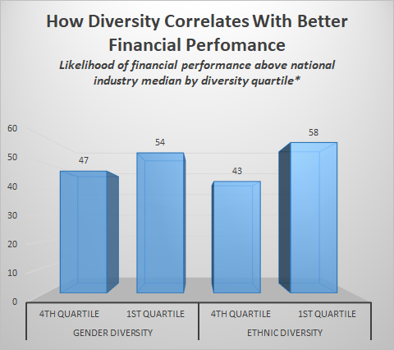
Diversity & Inclusion and Fiscal Performance
Lack of diversity leads to significant financial disadvantage!!!
The statistics are everywhere!
*source: McKinsey Diversity Database
Notes:
Studies routinely show that companies with diverse leadership teams tend to perform better financially, but perhaps most alarming is how poorly those companies lacking diversity do compared to the rest of their respective industries. In a 2015 report by McKinsey & Company it was found that companies that ranked in the bottom quartile in diversity performed 25% worse than the rest of their peers when measured by earnings before taxes and interest. That is, a lack of diversity correlates to a significant financial disadvantage.

Slide 7
The Diversity Continuum: “From K to Grey”
Only 20% of c-suite executives are women with only ~ 3% women of color
57% of college graduates are women.
Extent of problem
Dollars spent
Diversity and Inclusion programs exist across a continuum of ages - Multiple “on-ramps” for promotion of D&I
This team’s focus - entry level hiring

Slide 8
So why are WE still struggling?
90 ACE participants survey explains it
“As a hiring manager I get my slate from recruiting.”
“I haven't received guidance on tools - I rely on HR to provide diverse candidates.”
“Our HR recruiting team does the initial searching and screening”
“We have very little influence in the resumes we receive from HR.”
Front Line Managers don’t have the tools or resources to make this happen!

Slide 9
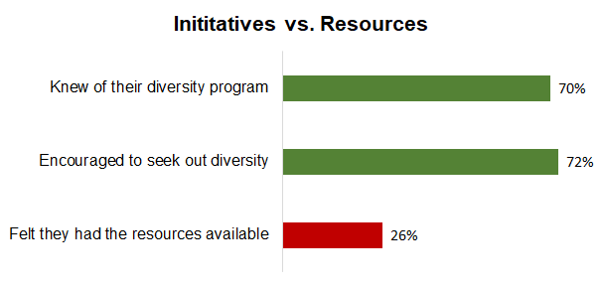
So why are WE still struggling?
90 ACE participants survey explains it
Front line managers don’t have the tools or resources to make this happen!

Slide 10
MHTA can help bridge this gap
Recommendation 1:
MHTA ACE Leadership Diversity & Inclusion Session
A “bottom up” approach to providing Minnesota’s future leaders with the tools to make a difference!
Recommendation 2:
MHTA Spring Conference Diversity Panel
“I wouldn’t lower my standards of excellence but I am willing to wait longer to see if we can get a more diverse pool of candidates to find the best fit”

Slide 11
We can change the narrative
Each ACE participant in the years to come can look back and say -
“I knew what to do. I did it and made a difference”

Slide 12
BACKUP

Slide 13
Hiring Manager’s Experience
Encouraged to seek out diverse candidates (was not always the case).
Hiring manager is pressured to fill the role quickly.
HR manager controls the stream of candidates the hiring manager sees.
Corporate measures the demographics of a location (or team) to determine diversity objectives.
No metrics visible that measures if the candidate pool is of sufficient diversity.

Slide 14
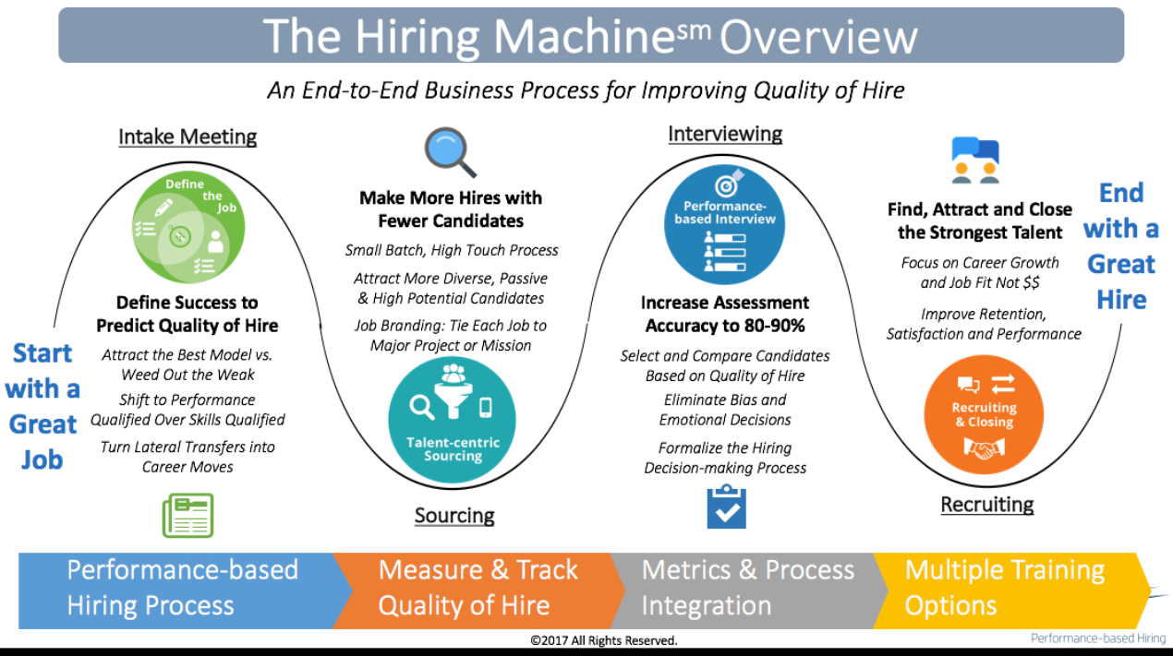
How HR views the hiring process
How the hiring manager views the hiring process

Slide 15
We have reached out to:
Jamf Contact
Df
Dfgd
fsdf
Educate the ACE’ers
Inform them of tools/resources
Provide advice/skills on how to handle timing/HR/constraints
I

Slide 16
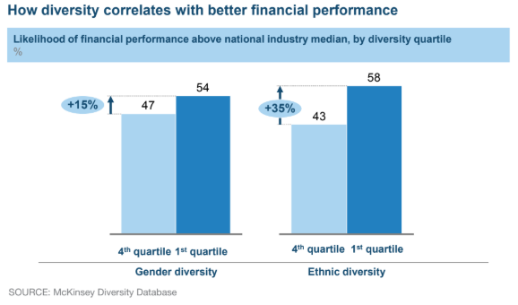
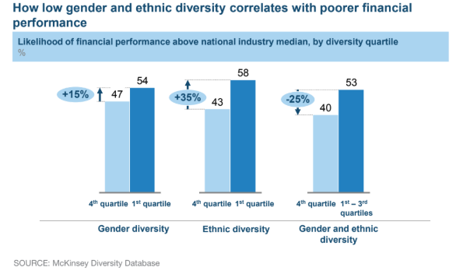
Diversity & Inclusion and Fiscal Performance
Nikki to fix
The statistics are everywhere!

